Slide 1
CANDY
Favorite candy
Edwin lopez

Slide 2
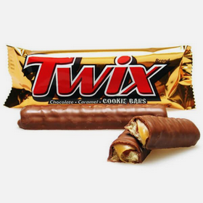
Twix chocolate
1

Slide 3
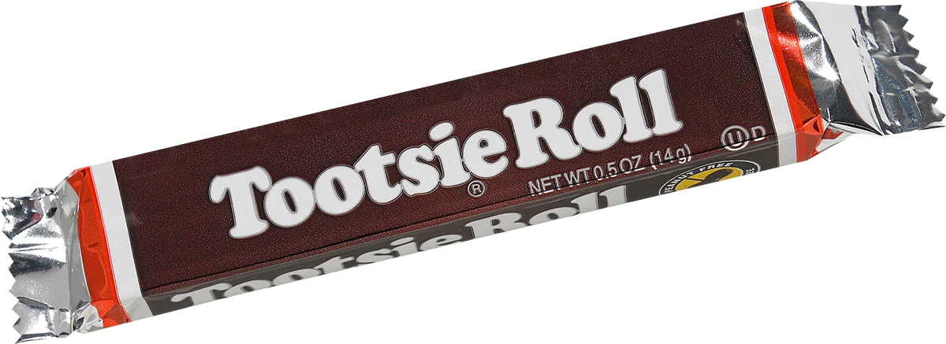
Tootsie rolls
2

Slide 4
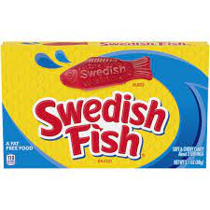
Swedish fish
3

